Slide 1
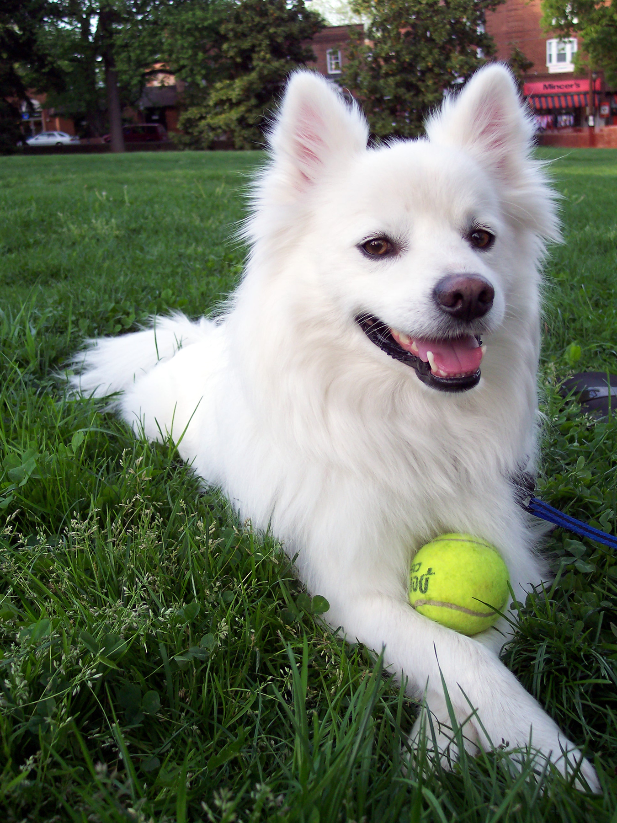
introuduction
Xmum student
This Photo by Unknown Author is licensed under CC BY-SA

Slide 2


Hi,nice to meet you guys ~ My name is Selina Hope we can all enjoy our college life

Slide 3
Here is a short self-introduction
My name is Liu xinting,English name is Selina.
I like singing , dancing ,watching film and programming (although I 'm not good at this).
I 'm from Xining which is the major city of Qinhai province.
I am very glad to be here in Xiamen university malaysia.

Slide 4




Thanks for watching

